Slide 1
Using Geography to Strengthen the
Decision-Making Process

Slide 2
Overview
Value of geographic perspective is a valuable tool for M&E.
Role of geographic data & tools in evidence-based decision making for M&E.
Geographic identifiers can be used to link data sets and
    Reduce “stovepiping “of data
    Improve recognition of spatial patterns
    Deepen the understanding of M&E program data
Using geography to link datasets can
  Increase collaboration with other organizations
  Expand the inventory of available data
  Lower costs.
Leveraging geography enhances evidence-based decision making & strengthens overall data infrastructure.

Slide 3

Notes:
There are more than 6 billion humans, and except for a handful of astronauts and wealthy space tourists, everything they do takes place here.

Slide 4
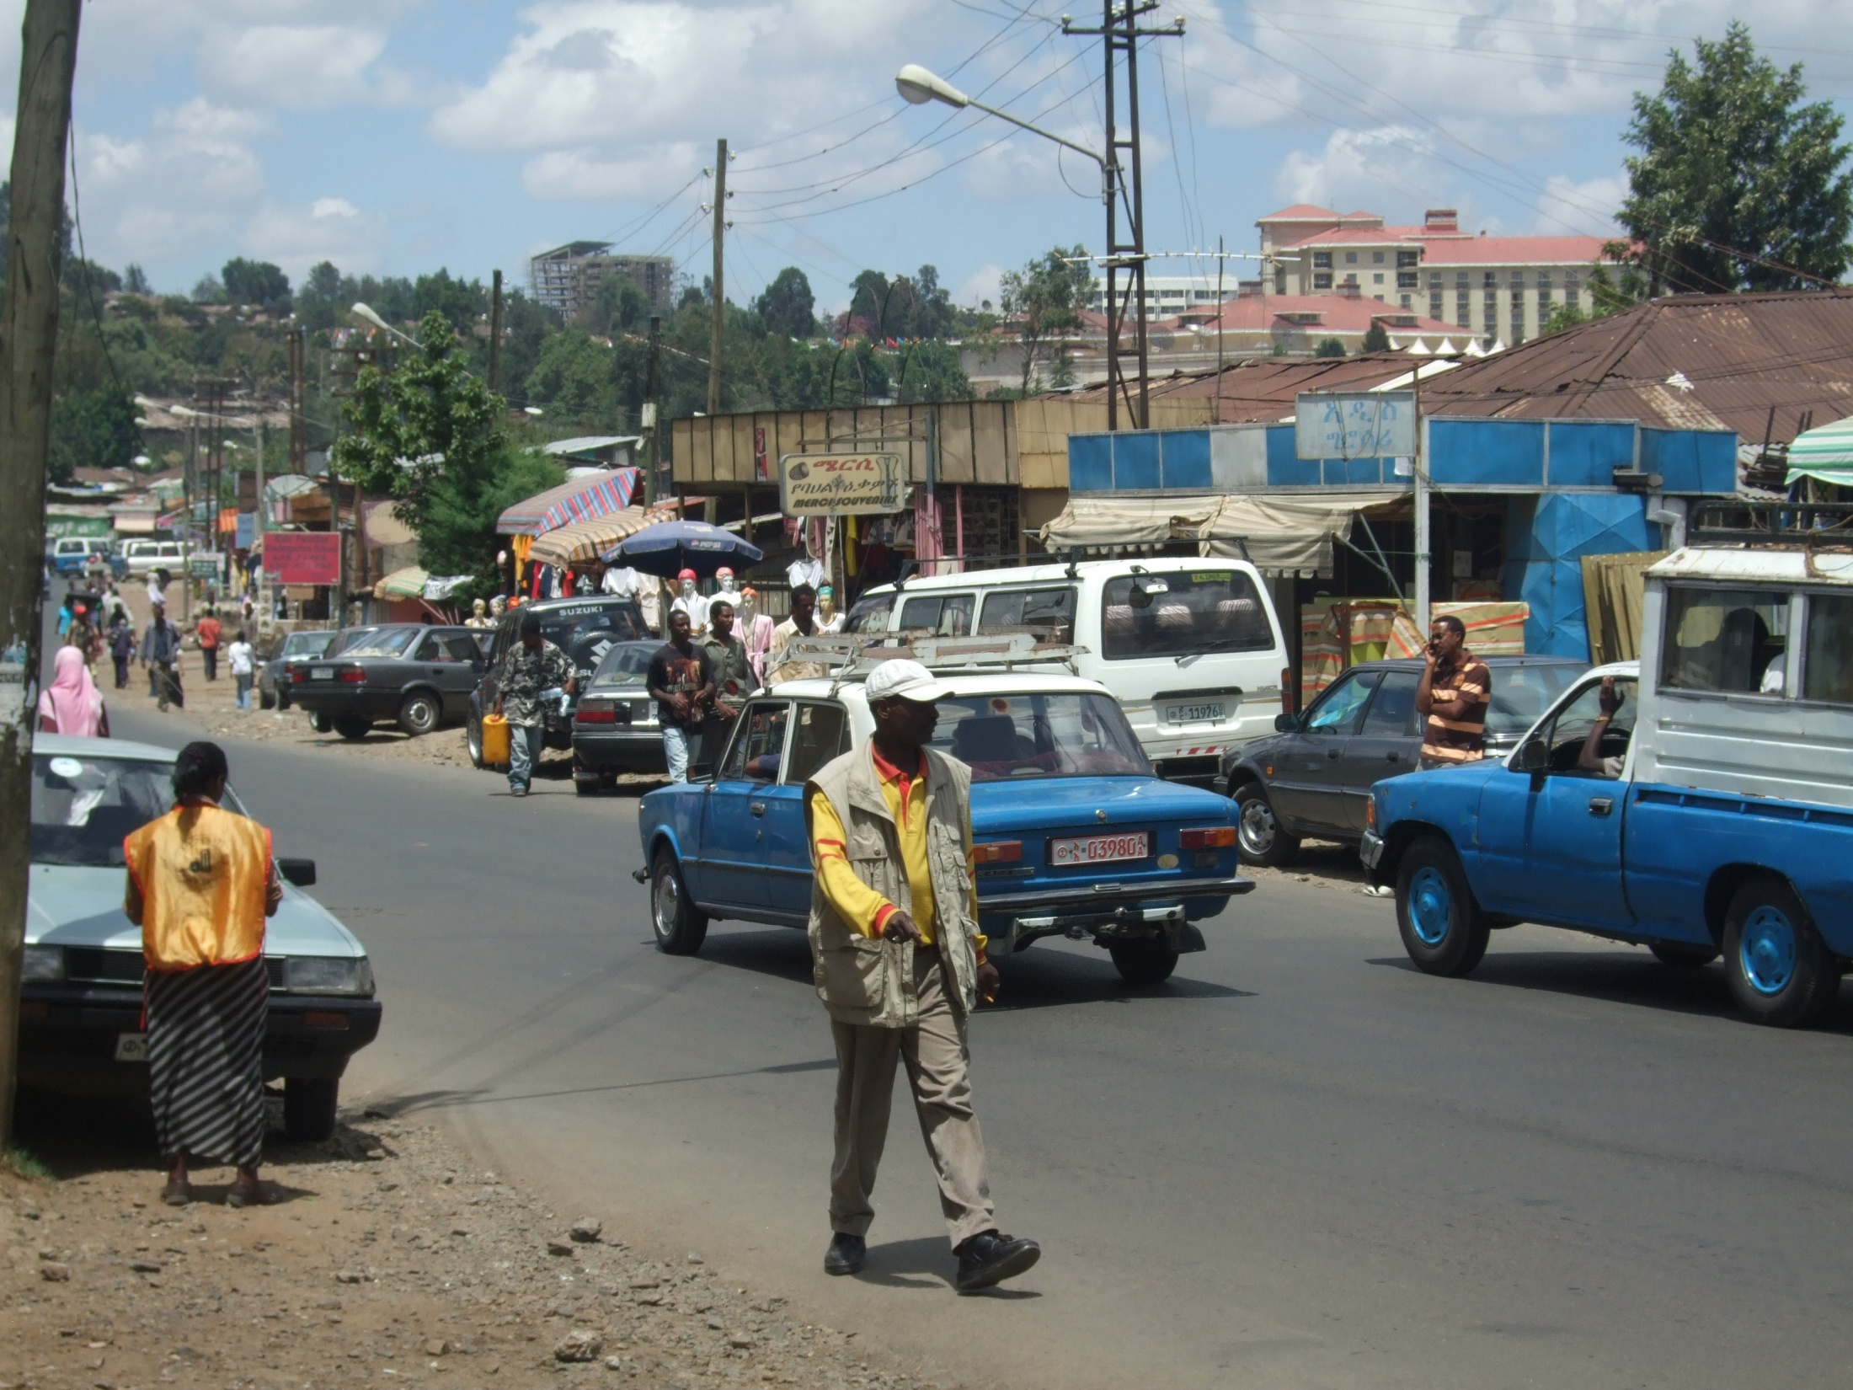
Notes:
You’ve got people living their lives,

Slide 5

Notes:
going to school,

Slide 6
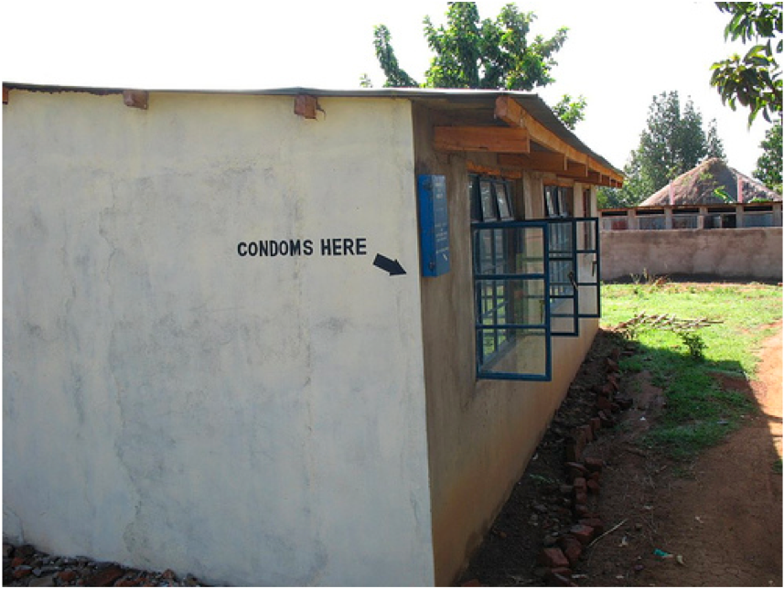
Notes:
seeking health care,

Slide 7
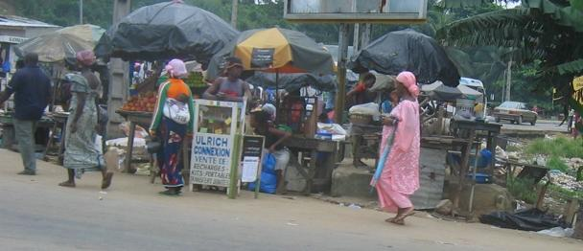
Notes:
or just trying to make a living.
M&E decision makers want to understand what’s going on so they collect numbers about human activity, such as HIV prevalence among orphans and vulnerable children, or number of persons living with HIV, or number of pregnant women receiving ART, or number of co-infections with HIV and TB.

Slide 8
Notes:
And because everything happens somewhere,

Slide 9

Photo by Eileen Maher
Notes:
And because like things tend to cluster, knowing the...

Slide 10
Where
Notes:
…can help us understand the…

Slide 11
Why

Slide 12
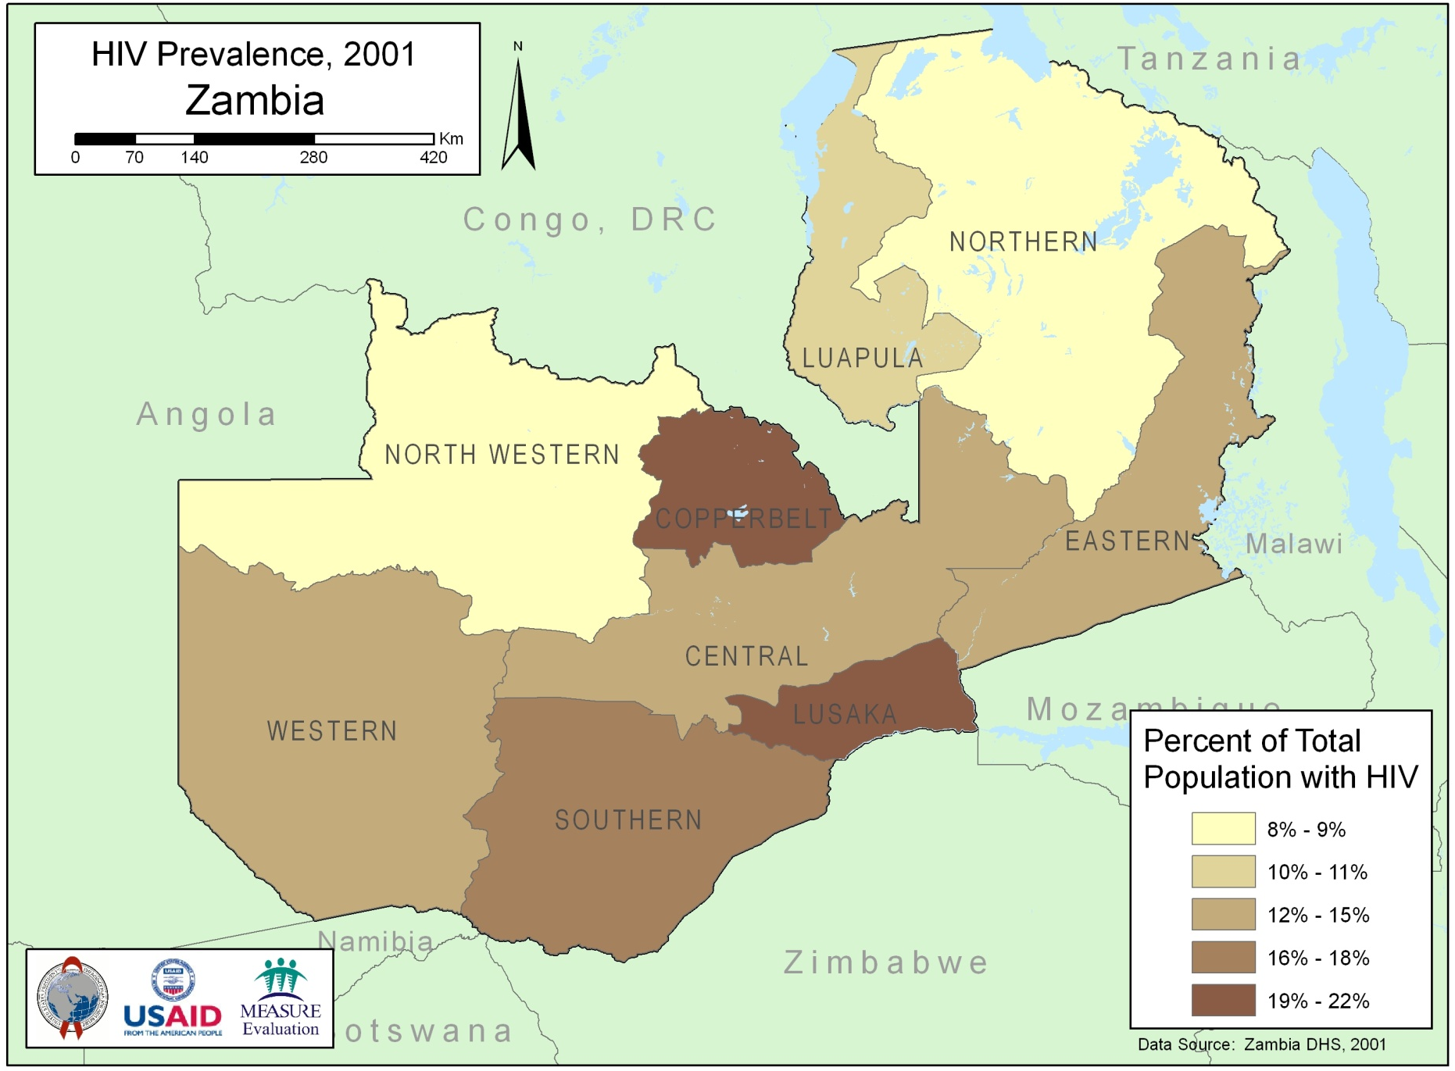
Notes:
Maps are a great tool for helping us visualize geographic data and understand the where.

Slide 13
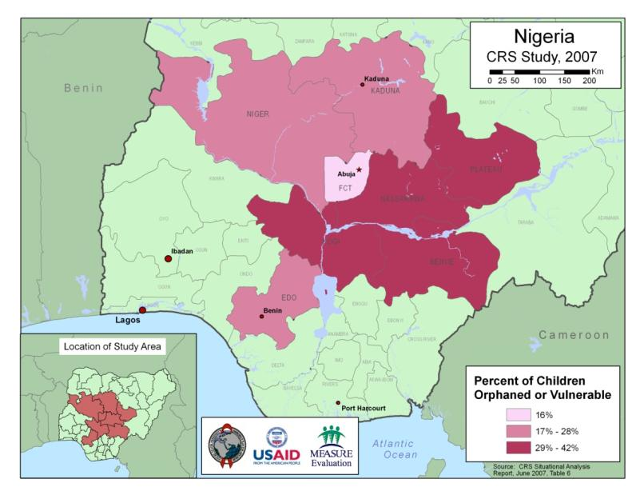
Value of Mapping
Facilitates recognition of spatial patterns
Provides insight into data
Highlights data quality issues
Provides a powerful tool for
  Decision support
  Analysis
  Data display
Picture worth 1,000 words

Slide 14
Value of Geography
More than just mapping
Strengthens data infrastructure by
  Providing a way to link different data sets
    Increases collaboration
    Expands inventory of available data
    Can lowers costs of data creation and maintenance
  Enforcing data schema standards
Notes:
Attaching a geographic component to health data provides much more value than simply being able to produce a map. It also strengthens the data infrastructure, first by providing a way to link different data sets—which increases collaboration with other organizations, increases the amount of available data, and potentially lowers the costs of developing and maintaining data—and second by enforcing standardization of data schemas, which define data base tables, fields, and their relationships.

Slide 15
Geography Can Strengthen The Data Infrastructure
Notes:
To reiterate…

Slide 16
A Strong Data Infrastructure Makes Better Decisions and Better Outcomes More Likely

Slide 17

Data Infrastructure
Available data
Systems to support, update, and disseminate data
Notes:
Before proceeding, it might be helpful to define the term “Data Infrastructure.” Simply put, Data Infrastructure refers to all of the available data and the systems needed to support, update, and disseminate data. In the context of OVC mapping, for example, we’re concerned with the OVC data infrastructure. Because the identification and treatment of OVC is a complex process that responds to changes across many aspects of society, the OVC data infrastructure is also complex. To have a full understanding of the OVC situation in a particular country, therefore, will require a robust, mature data infrastructure.

Slide 18

Data Streams
Notes:
Data are often available from many individual sources, such as health and education ministries, NGOs, universities, and national mapping agencies. Often, however, these data streams are not connected—there’s no sharing going on, whether through lack of awareness, too many administrative barriers, or even turf battles. This is referred to as “stovepiping” of data.

Slide 19

The world is complex; take advantage of as much data as possible
Notes:
The world is complex, however, so it’s better to take advantage of as much data as possible to understand the true situation and achieve program goals and objectives. Also, leveraging data from other organizations not only increases collaboration, which can produce short- and long-term benefits, but can also expand the amount of data available for decision making and lower the cost of developing and maintaining data.

Slide 20
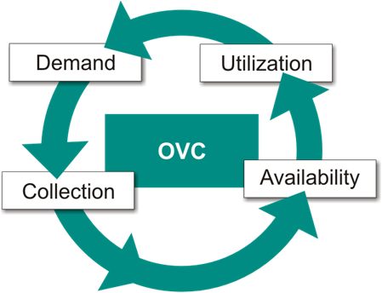
Notes:
There is a cycle to data demand and use. The cycle begins with a demand for information. That demand leads to collection of data, which are then cleaned and made available. Once data are available they are turned into information and used by decision makers, which in turn fuels demand for more data.

Slide 21
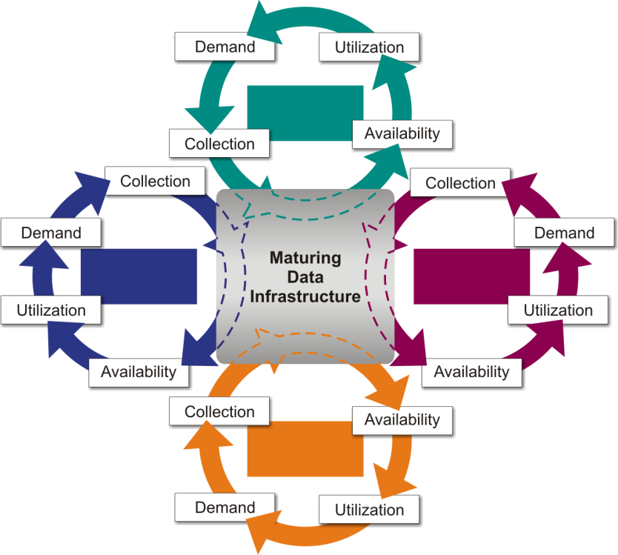
OVC
ART
PMTCT
Public
Health Data
Notes:
This cycle occurs in individual programs throughout the health sector within a country. If individual programs collaborate—which will expand the amount of data available and lower costs—it can significantly mature and strengthen the national data infrastructure.

Slide 22
Geography is key link
Population
OVC
District | Population
North | 3253
South | 5621
East | 8732
West | 7715
District | OVC
North | 812
South | 1011
East | 2709
West | 1411
Notes:
Geography is the key link to facilitate data sharing. If one agency has population data, for example, and another has OVC data, without linking the data sets there’s no way to use them together to gain a greater understanding of the OVC situation in the country. If one wanted to see percent OVC by district, for example, there would be no way to do it.

Slide 23
Geography is key link
Population and OVC
District | Population | OVC | Percent OVC
North | 3253 | 812 | 24.96
South | 5621 | 1011 | 17.99
East | 8732 | 2709 | 31.02
West | 7715 | 1411 | 18.29
Notes:
Once the two data sets are linked, however, one could easily calculate percent OVC by district. And if district boundaries were available in electronic format, one could produce a map showing this theme.

Slide 24
Geography is key link
Seems obvious
Data need to have a geographic identifier
Data must have complementary structure
  One record per observation
  Consistent geographic identifiers
  Compatible level of geographic representation
Don’t necessarily need a GIS—data can be linked and shared in Excel or Access
Notes:
Geography is the key link that facilitates data sharing. After a little scrutiny, this seem obvious.
The main requirement for linking data from different sources is that each observation in the different data sets possess a geographic identifier. Also, the data sets must use complementary structures, which would include one record per observation, consistent geographic identifiers, and a compatible level of geographic representation.
You don’t necessarily need a full-blown geographic information system (GIS) for this, as data can easily be linked and shared using simpler tools such as Excel or Access.

Slide 25
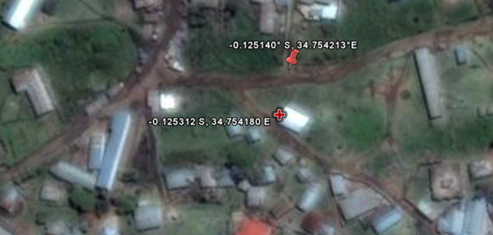
Geographic Identifiers
-0.125312 S
34.754180 E
-0.125140 S
34.754213 E
Notes:
Let’s talk a bit about geographic identifiers. Geographic identifiers are pieces of information that specify the physical locations of things. Geographic identifiers can help locate point-based entities, such as hospitals, clinics, or individual households. For these point-based entities, geographic identifiers can be derived from GPS coordinates, such as the ones shown in this slide.
One thing to note is that geographic identifiers are different from unique identifiers. Geographic identifiers specify physical locations, whereas unique identifiers specify individual observations. GPS coordinates are somewhat long and aren’t always unique—since it’s possible for two GPS points to have the same location—so they shouldn’t be used as unique identifiers.

Slide 26
Geographic Identifiers
Administrative units
  Provinces
  Districts
  Communes
  Etc.
Village or community name
Notes:
Geographic identifiers can help locate point-based entities, such as hospitals, clinics, and households, but they can also be used to link data to administrative units, such as provinces, districts, and communes, or to individual villages or communities.

Slide 27
OVC Case Study
Nigeria
Notes:
Once geographic identifiers have been attached to data, you can tap into the power of geography and mapping. To illustrate the power of geography and mapping, I’d like to present a case study from Nigeria based on a situational analysis of OVC conducted by Catholic Relief Services in early 2007.
As background, Nigeria has one of the largest populations of orphans in the world, and a large proportion of Nigerian orphans were orphaned due to AIDS (18.4 % in 2001 according to the Nigerian Federal Ministry of Women Affairs and UNICEF).
Therefore, to augment the situational analysis and gain a better understanding of the OVC situation, CRS Nigeria asked MEASURE Evaluation to create some maps.

Slide 28
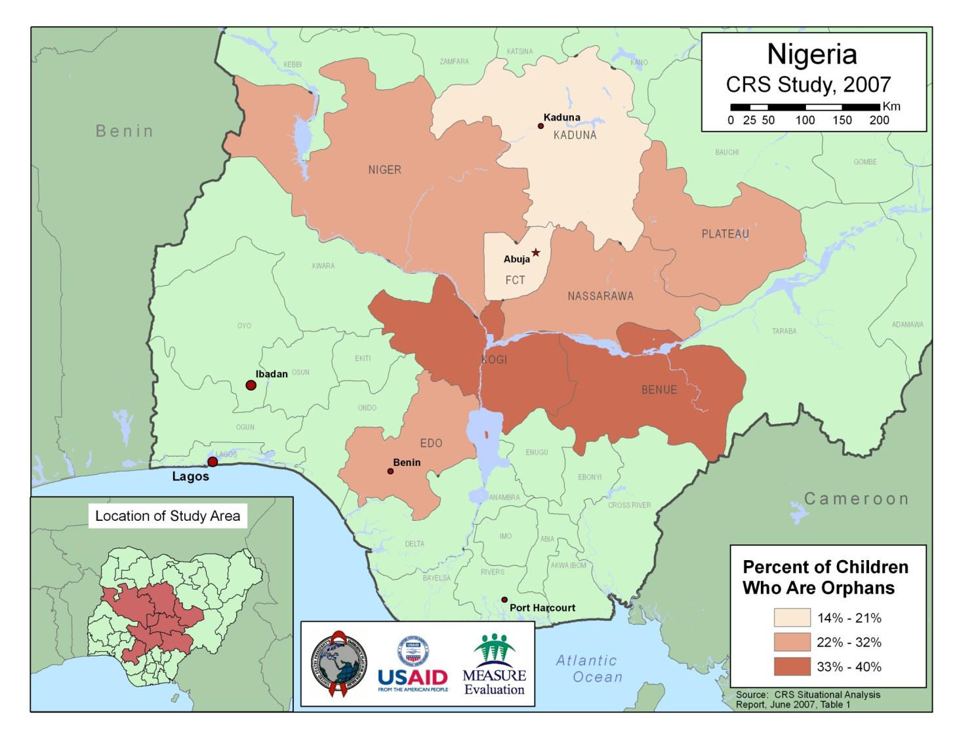
Notes:
As you can see on this first map, the situational analysis was conducted in eight states in central Nigeria. The variable mapped was percent of children who are orphans. If you look at the legend in the lower right corner you can see that the percent of children who are orphans ranged from 14%, shown in light tan, up to 40%, shown in darker brown.
This map was a good start to understanding the spatial distribution of orphans, but it was a basic map of a single variable, and so it didn’t come close to providing a complete picture of the OVC situation in the country.

Slide 29
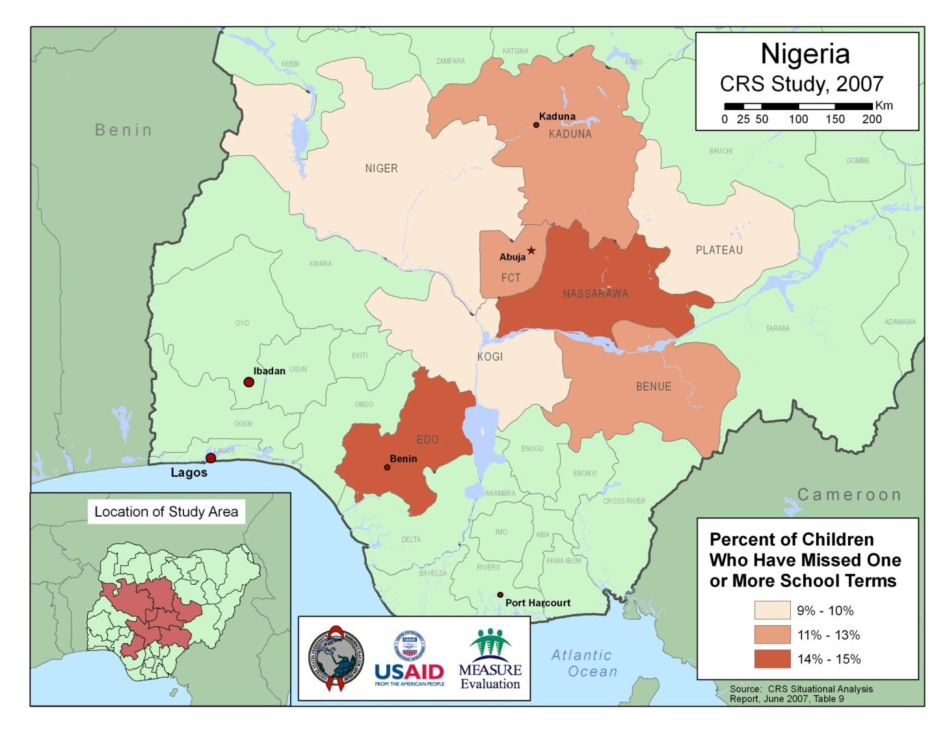
Notes:
So MEASURE Evaluation also mapped the percent of children who have missed one or more school terms.
This is another example of mapping a single variable. To gain a deeper understanding of OVC issues, we also mapped combinations of variables.

Slide 30
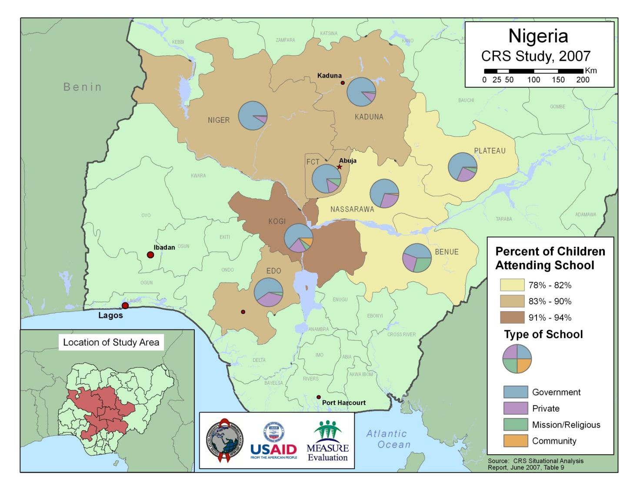
Notes:
In this map, for example, MEASURE Evaluation mapped the percent of children attending school in relation to the type of school being attended.

Slide 31
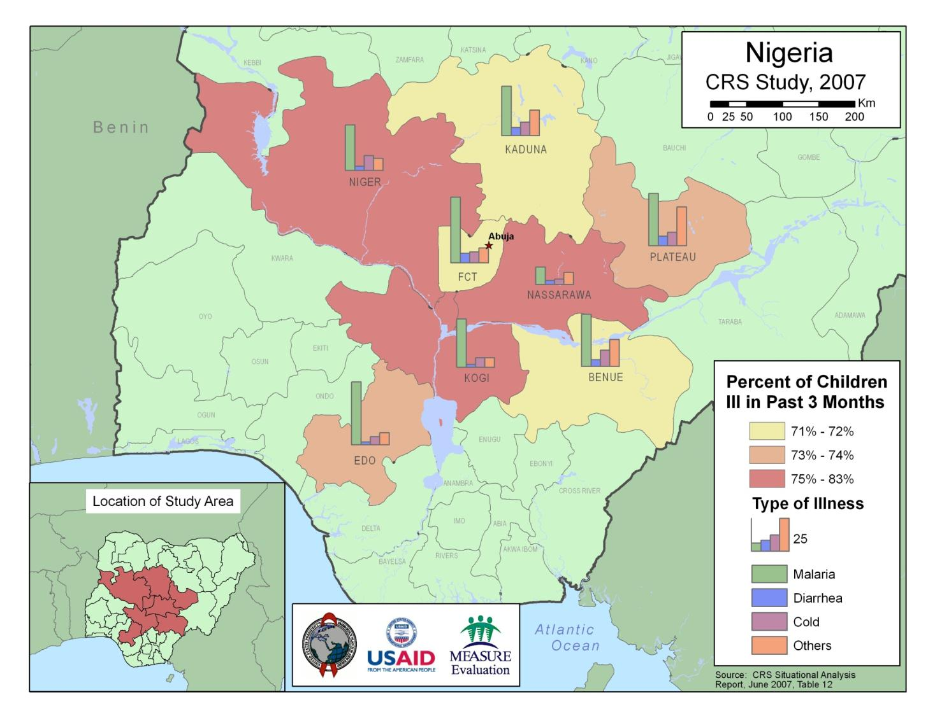
Notes:
* And in this one we mapped the percent of children who were ill in the past three months in relation to the type of illness. This map showed that malaria was the most significant illness affecting children in the study area, but that other illnesses were more prevalent to the north and east of the capital.
* We mapped several variables to help CRS Nigeria gain a better understanding of the data. The maps I’m showing here are just some of those created. I’ve included them because they’re representative of some of the different ways data can be viewed geographically.
* The last map from the case study I’d like to show really illustrates how data from different sources can be linked geographically. It also shows how linking data from different sources can reveal hidden relationships between variables.

Slide 32
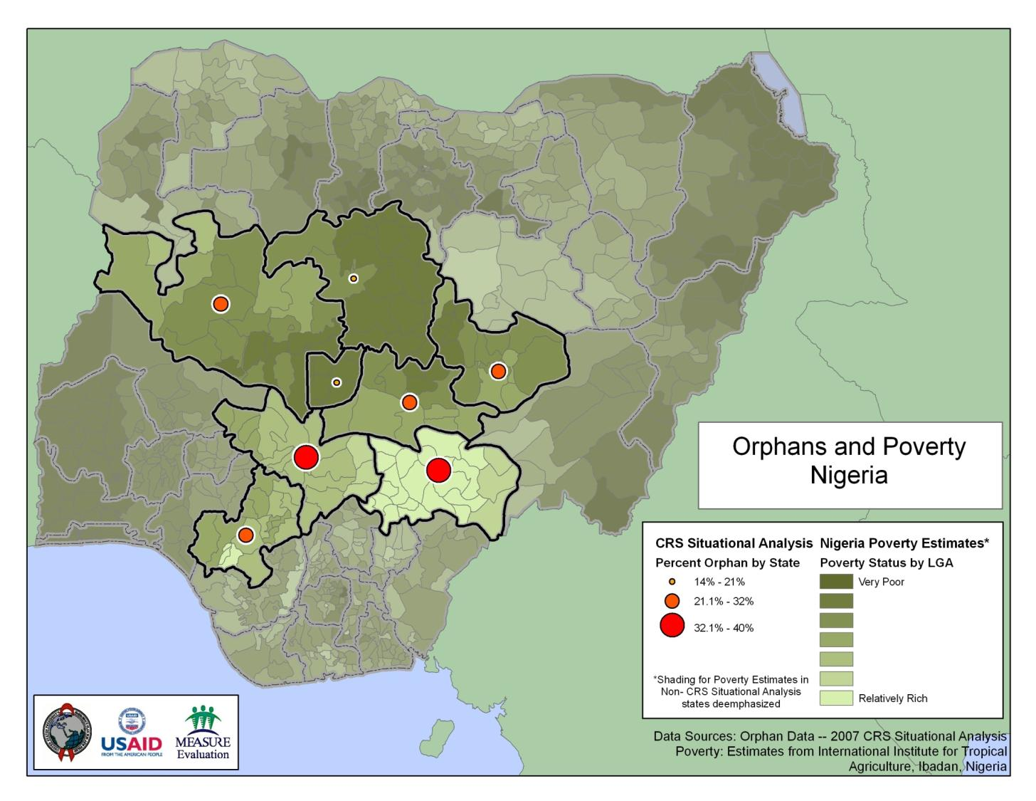
Notes:
*According to the CRS Situational Analysis, issues of poverty can not only make children more at risk for illness, malnutrition, and other undesirable conditions, but it can contribute to the inability of guardians to care for OVC. Since the CRS report didn’t report findings specific to poverty, however, in order to create a map it was necessary to obtain poverty data elsewhere.
* In 2005 the International Institute for Tropical Agriculture (IITA) published the results of a rural livelihoods survey in Nigeria. The primary goal was to assess the relationship between rural livelihoods, poverty, and food demand. As part of the study, they developed a national poverty estimate at the LGA level. LGAs, or local government areas, are below states in the administrative hierarchy.
* MEASURE Evaluation created a map showing poverty vs. percent orphans by combining these previously separate data sets using geographic identifiers as the common link. Although it wasn’t done for this map, since LGAs nest within states, the LGA-level data could also have been summarized at the state level for mapping.
* In terms of results, you might expect there to have been a higher percentage of orphans where there was a higher rate of poverty. If you look at the map, though, you’ll see that percent orphan was lowest where poverty was highest. This was somewhat surprising, and is a great example of how linking different data sets and putting them together on a map can help lead to a deeper understanding of a target population.

Slide 33
The world is complex; take advantage of as much data as possible
Notes:
To revisit a slide presented earlier, the world is complex, and you should take advantage of as much data as possible to help understand it.

Slide 34


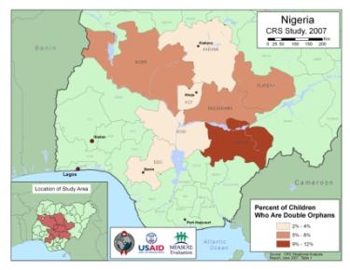


Mapping: One Tool in the Toolbox
Notes:
It’s important to remember, though, that mapping is just one tool in the toolbox. It’s not a panacea, but it can help visualize data and lead to a deeper understanding of program needs and priorities.

Slide 35
Key Steps to Mapping
Include Geographic Identifier in Data
  Where are things?
Select Software
  ArcGIS
  DevInfo
  Diva-GIS
  Excel to Google Earth
  Google Earth
Notes:
What are the key steps to mapping?
First, make sure you include a geographic identifier for each record in your data. This will tell you where things are.
Second, select the software that’s right for your situation. ArcGIS is powerful, but it’s also complex and takes a fair amount of time to learn, set up, and maintain. It’s also expensive. There’s also DevInfo and Diva-GIS, which are both free. And there’s Google Earth and the Excel to Google Earth program created by MEASURE Evaluation, which are also both free. I’ll discuss software options in more detail later on. The important thing is to know that there are several options available, depending on your needs, budget, and capabilities.

Slide 36
Power of Geography and Mapping
Data quality
  Target efforts for improving data quality
  Strengthen data quality by enforcing data schema standards
  Demonstrate value of high quality data
Decision making
  Facilitate Data Visualization
  Demonstrate impact of programs
  Integrate various data sources
Notes:
To review some of the benefits of geography and mapping, with respect to data quality they can help
* target efforts for improving the quality of data;
* strengthen data quality by enforcing data schema standards; and
* demonstrate the value of using high quality data to achieve better results.
In terms of decision making, they can help you
* visualize your data;
* see the geographic impact of program activities; and
* integrate data from complementary sources.

Slide 37
Power of Geography and Mapping
Adding the “where” can help understand the “why”
Geography can act as a “Rosetta Stone” to link different elements of the data infrastructure
Notes:
More importantly, adding the where can help understand the why.
Also, geography can act as a sort of “Rosetta Stone” to allow different elements of the data infrastructure to be linked. And as I’ve said a few times now, linking data sets can increase collaboration, expand the amount of data available, and lower costs. Along with data schema standardization, this can significantly strengthen the data infrastructure.

Slide 38
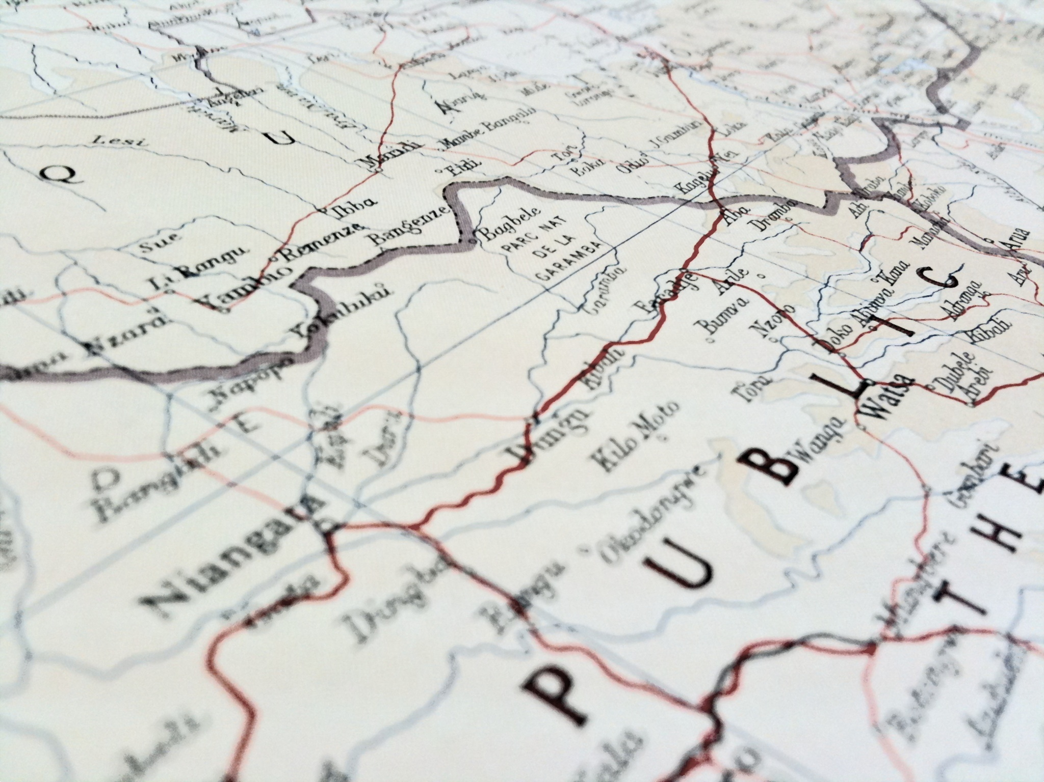
Everything happens somewhere
Notes:
Everything happens somewhere, so take advantage of it to help you achieve your program goals and objectives.

Slide 39
Discussion Questions
Can anyone provide an example of how the use of geography and mapping has helped improve the decision making process within his or her country or organization?
Can anyone provide an example of stovepiping of data? And do you see this as a problem for your country or organization?

Slide 40
Discussion Questions (cont’d)
If you’re affected by stovepiping of data, how do you think you could overcome it? Or if you’ve had to overcome stovepiping in the past, how did you accomplish it?
Has anyone had a positive experience with linking to external data sets? Such as linking to data from the national mapping agency (NMA), other ministries, universities?

Slide 41
Discussion Questions (cont’d)
Has anyone here collaborated with the NMA to obtain data? Can you share any lessons learned?

Slide 42
General Objective
The general objective of the module « Fundamentals of Geographic Data » is to present the fundamentals of geographic data, including the relationship between geographic and attribute data, and to help participants understand some important data quality considerations.

Slide 43
Session Plan
Geographic data
Geographic identifiers
Data schema best practices

Slide 44
Notes:
As we discussed earlier, everything happens somewhere, so there is a geographic component to human activity. This geographic component can be captured using geographic data, also known as spatial data.

Slide 45
Geographic
Identifiers
Notes:
As we discussed in the introduction, geographic data are those that represent physical locations. There are many different ways to present the location of something. These methods are known as geographic identifiers.

Slide 46
Geographic Identifiers
GPS coordinate
Administrative name
In reference to other features
Notes:
We’ll talk in detail about the following geographic identifiers

Slide 47
Geography basics
Notes:
Before getting into the geographic identifiers, it would be helpful to describe a basic concept: latitude/longitude

Slide 48
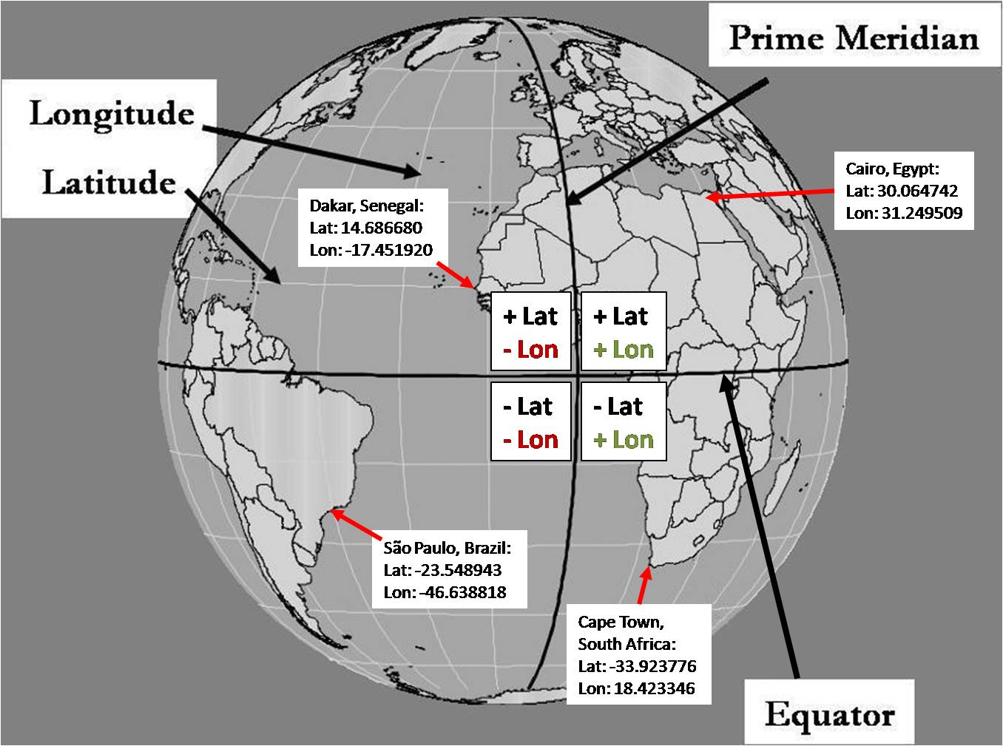
Latitude/Longitude
Notes:
Latitude and longitude is one of the most commonly used ways to locate something on Earth.
Latitude refers to how far north or south a point is from the equator (The equator is a line across the globe that is exactly halfway between the north and south pole). Latitude coordinates above the equator have positive values, latitude coordinates below the equator have negative values.
Longitude refers to how far East or West a point is from the prime meridian, which is a line that runs through Greenwich England, around to the other side of the globe and forms the International Date Line. Locations that are east of prime meridian are positive and locations that are west of the prime meridian are negative.

Slide 49
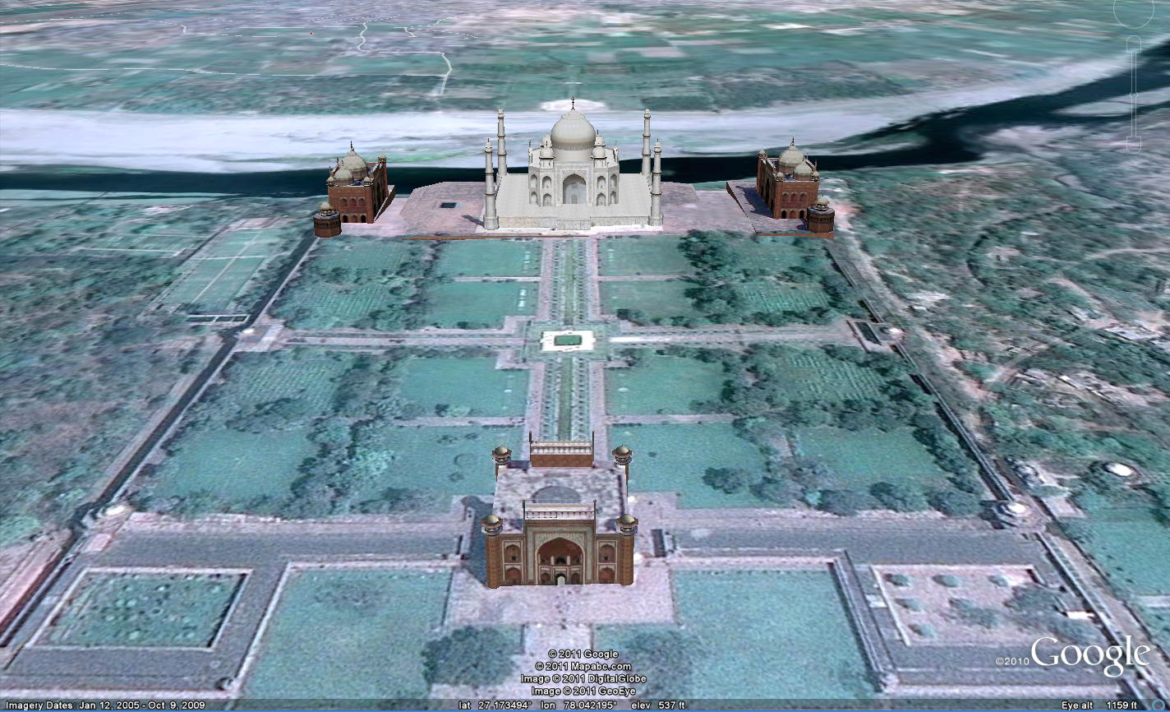
Taj Mahal: 27.17 Latitude 78.04 Longitude
Notes:
For instance, the Taj Mahal is located at 27.17 degrees latitude, 78.04 longitude. This means that it is 27.17 degrees north of the equator and 78.04 degrees east of the Prime Meridian.

Slide 50
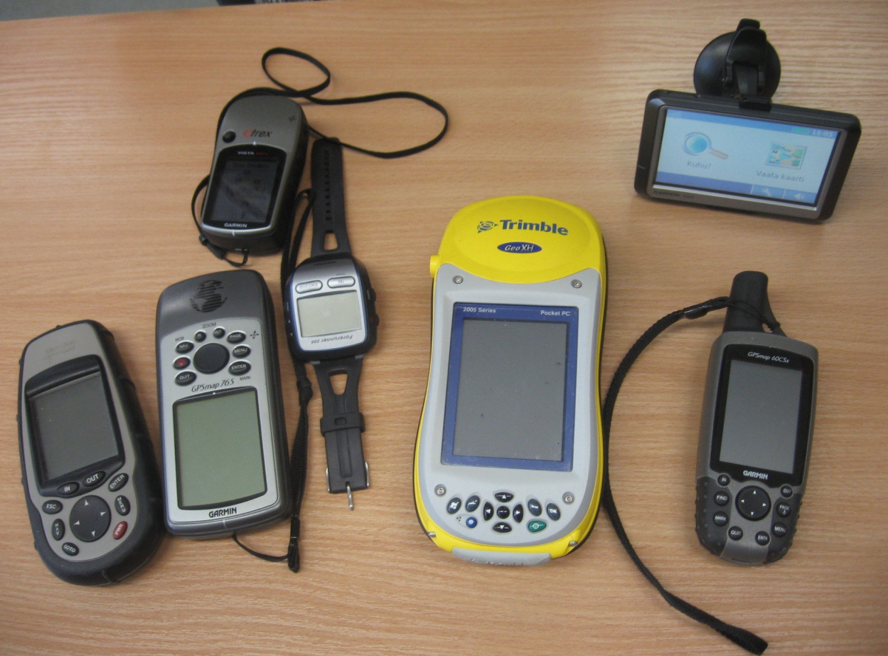
GPS Coordinate
Global
Positioning
System
Notes:
GPS stands for Global Positioning System. It allows people to use receivers like those pictures and get the location of something. So if you took one of these receivers to the Taj Mahal, the coordinate it would give you is: 27.17, 78.04

Slide 51
GPS Coordinates
Advantages
Disadvantages
Very accurate:
  10 meters or less
Easy to get a quick location of a few objects
Receivers and devices becoming more affordable
If many objects need to be located, there needs to be a well designed data collection protocol
Capturing something other than a point can add time and cost
Notes:
Here are the advantages and disadvantages with GPS coordinates:
<READ SLIDE>
Disadvantage: “Capturing something other than a point can add time and cost” – Most inexpensive GPS receivers capture just a single point. In order to capture a road or the boundaries of a lake or other feature requires a receiver that is more expensive

Slide 52
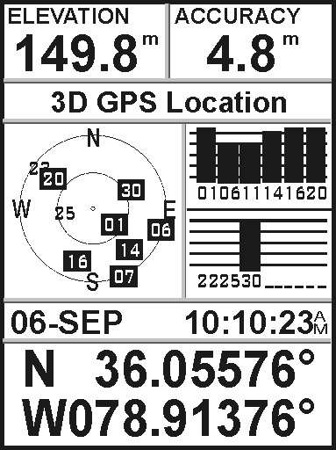
GPS Coordinate
Best practice:
  Display as latitude/longitude coordinate
Example:
  36.05576
  078.91376

Slide 53
Geographic Identifiers
Administrative division names or codes
  Regions, provinces, districts, communes
Human settlement names or codes
  Cities, villages, neighborhoods, informal settlements
Exact locations
  Street addresses, GPS coordinates
Notes:
* Some common geographic identifiers are shown on this slide.
* First we have administrative division names or codes, such as those used for regions, provinces, districts, etc. In terms of mapping administrative divisions for decision making, administrative division names or codes are associated with areas rather than specific points, and the corresponding divisions would be represented on a map as polygons.
* Then there are human settlement names or codes, such as the names or codes for cities, villages, etc. The corresponding geographic entities could be mapped as areas or polygons if their boundaries have been put into digital format, or as points if showing a generalized location.
* Lastly there are exact locations, such as street addresses or GPS coordinates. These would be mapped as points.

Slide 54
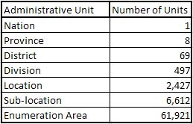
Geographic Identifiers: Administrative Divisions
Kenyan Geographic Hierarchy for 1999 Census
Source: Odhiambo, Emma. “Census Cartography: The Kenyan Experience,” presented at the United Nations Expert Group Meeting on Contemporary Practices in Census Mapping and Use of Geographical Information Systems, 29th May – 1st June 2007, New York.
Notes:
Administrative divisions are areas defined by governments to facilitate administration of government services or identify distinct geographic, ethnic, or cultural regions in a country. Administrative divisions often have a hierarchical relationship, where the units at a higher level are made up of a collection of units at a lower level.
For example, as shown in this slide, the Kenya National Bureau of Statistics uses a well-defined hierarchy for census data collection. The primary administrative division is the nation, and below that are the provinces. Provinces are further divided into districts, districts into divisions, and divisions into locations. Locations are comprised of sub-locations, and below that is the lowest level of the hierarchy, the enumeration area (EA), which usually contains between 51 and 150 households.

Slide 55
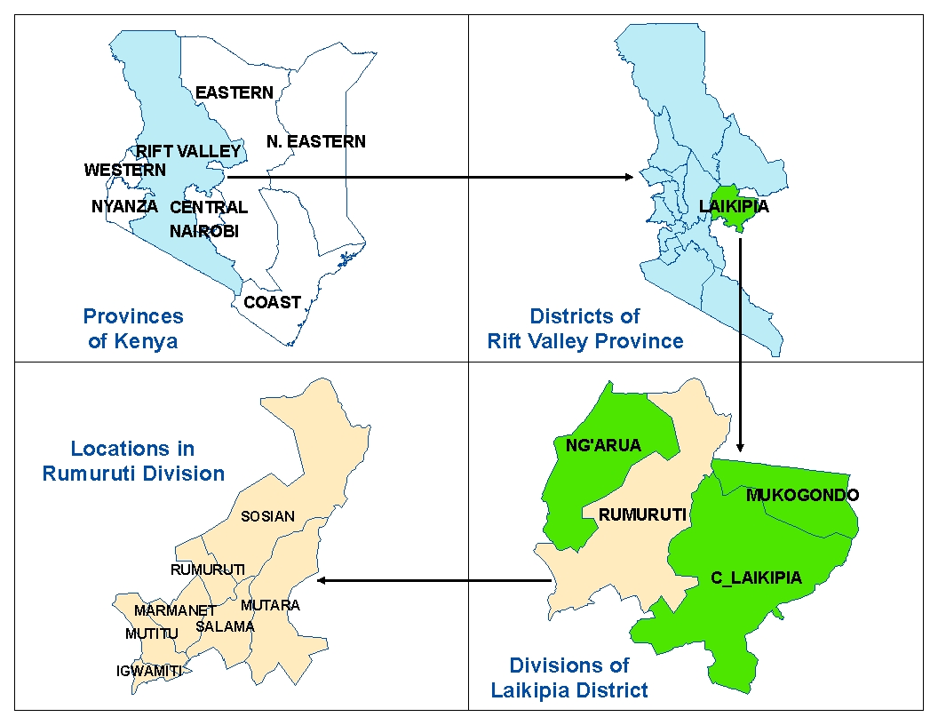
Acknowledgments:
USAID, FEWS, EDC-
International Program, and
the U.S. Geological Survey.
Notes:
* This slide shows how the geographic areas in Kenya get smaller as one moves down the hierarchy, from provinces to districts, from districts to divisions, and from divisions to locations.
* A well-defined geographic hierarchy is critical for aggregating data from a detailed level to a higher level for analysis and reporting. This can greatly facilitate the decision-making process, as many decisions rely on a more synoptic view of data.
* Also, a well-defined geographic hierarchy can provide the foundation for the establishment of unique geographic identifiers. Non-unique geographic identifiers become more common as one travels down the hierarchy to a more detailed level. Having unique geographic identifiers for a given level of the hierarchy, however, greatly reduces confusion and therefore enhances the decision-making process.
* Let me show you an example.

Slide 56
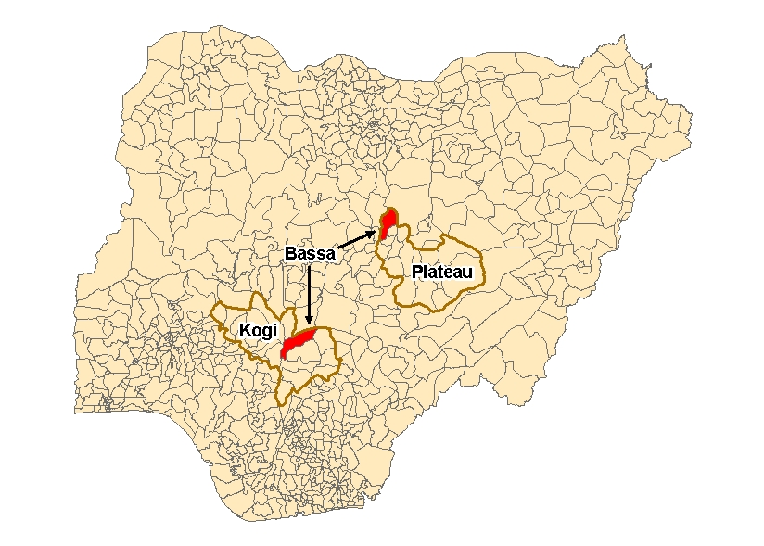
Source:
Administrative boundaries downloaded
October 2008 from http://gisweb.ciat.cgiar.org/povertymapping/.
Notes:
In Nigeria, based on administrative boundaries for 2002 developed by the International Institute for Tropical Agriculture, there are two local government areas (LGAs) named Bassa, one in the state of Kogi, and one in the state of Plateau. For geographic analyses, these non-unique administrative names could cause some confusion.
The geographic hierarchy can help eliminate this confusion. In this case, combining the LGA name with the state name would yield a unique geographic identifier.

Slide 57
Geographic Identifiers:
Human Settlements
  Cities
  Towns
  Villages
  Neighborhoods
  Communities
  Informal settlements
Notes:
In addition to administrative division names or codes, geographic identifiers can be based on names or codes for human settlements, such as those used for cities, villages, neighborhoods, etc.

Slide 58
Geographic Identifiers
Anything that helps uniquely identify where something is
Notes:
So to summarize: a geographic identifier is something that helps uniquely identify where something is.

Slide 59
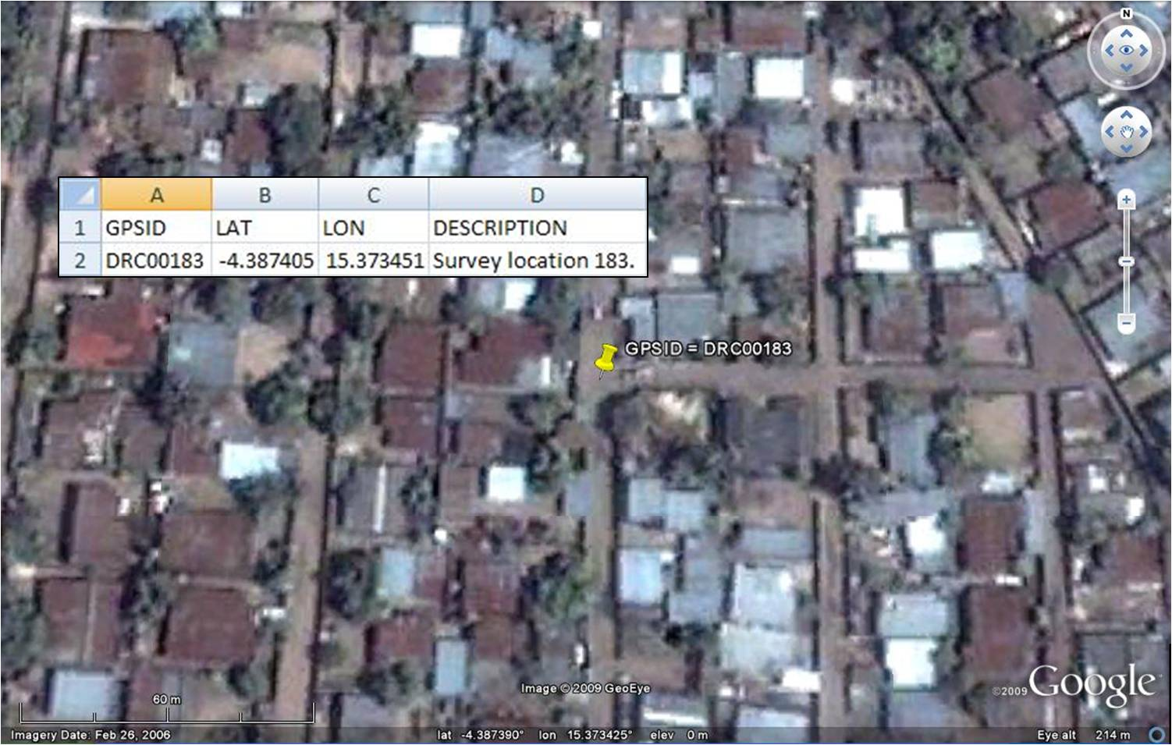
Notes:
And here’s a point location in The Democratic Republic of the Congo using simulated GPS coordinates as the geographic identifier. The coordinates are simulated in that they were chosen at random, and are not connected with any real survey.
* Now that we’ve talked about geographic identifiers, which help assign physical locations to your M&E data, I’d like to discuss how they relate to the quality of your M&E data.
* The best way to approach this is to talk about the implementation of …

Slide 60
MEASURE Evaluation is a MEASURE project funded by the
U.S. Agency for International Development and implemented by
the Carolina Population Center at the University of North Carolina
at Chapel Hill in partnership with Futures Group International,
ICF Macro, John Snow, Inc., Management Sciences for Health,
and Tulane University. Views expressed in this presentation do not
necessarily reflect the views of USAID or the U.S. Government.
MEASURE Evaluation is the USAID Global Health Bureau's
primary vehicle for supporting improvements in monitoring and
evaluation in population, health and nutrition worldwide.

